Slide 1
Extended data demo

Slide 2
Datasets

Slide 3
Search filters

Slide 5
Events

Slide 6
Sites

Slide 7
Map

Slide 8
Downloads

Slide 9
Download formats

Slide 10
What is Pipelines ?

Slide 11
What is Pipelines ?
DWCA
Web
Services
Web
Services
Pipelines
Search
Index
Occurrence
Web
Services
Web
Services
Atlas
Web
Services
Interpreted
Output

Slide 12
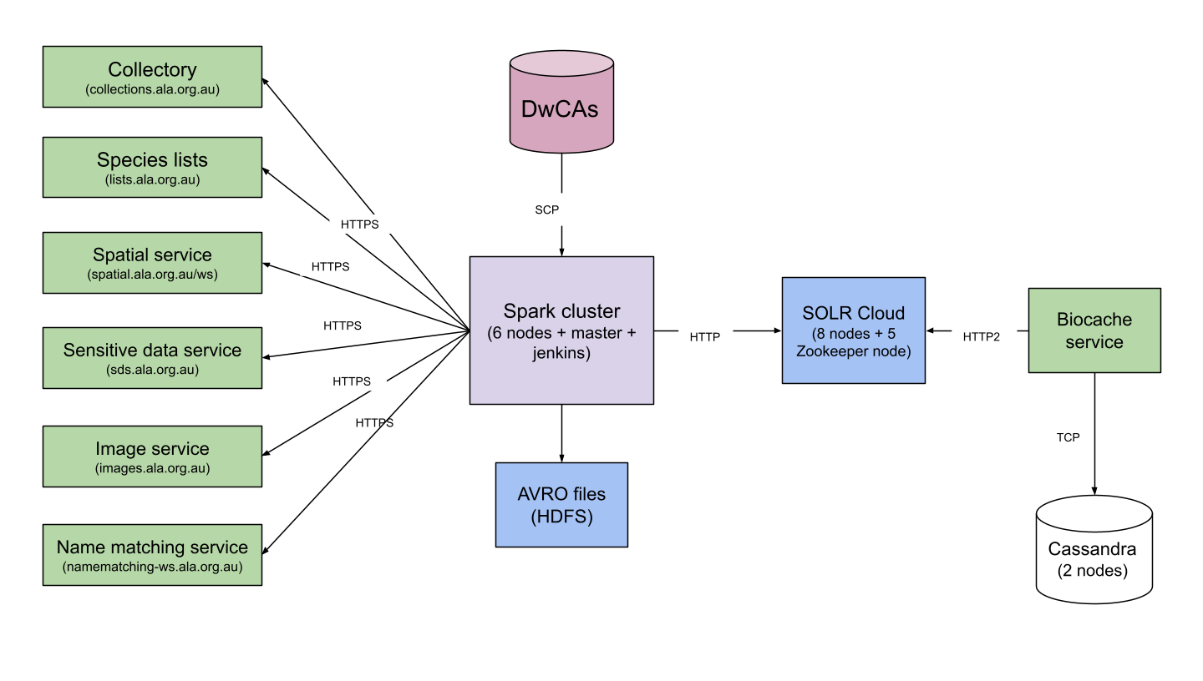
Architecture

Slide 13
Pipelines - the purple box
Pipelines
DWCA
Verbatim AVRO
Pipeline
Interpretation Pipeline
UUID
Pipeline
SOLR
Pipeline
SOLR
Cluster
Biocache
Service
Location Transform
Sensitive
Pipeline
AVRO
Index
Pipeline
Taxonomy Transform
Attribution Transform
Temporal Transform
Image
Pipelines
Duplicate
Detection
Pipeline
Multimedia Transform
Verbatim Transform
Sampling
Pipeline
Jackknife
Pipeline

Slide 14
Technology

Slide 15

Apache Beam
The API used as the basis for Pipelines
“Pipelines”
“Transforms”
Platform independent
Write once - run on different data processing engines
Spark
Flint
Google Cloud Engine
Data
Beam Pipeline
Output
Transform 1
Transform 2
Transform 3
Transform
4

Slide 16

AVRO
Data Serialisation
Binary files with Schema
JSON schema
Language independent
Widely supported
AWS
Google Cloud
Microsoft Azure

Slide 17
Apache Spark + Hadoop (HDFS) Deployment
Spark cluster
Jenkins
Spark master VM
Spark VM - 1
Spark VM - 2
Spark VM - 3
Spark VM - 4
Spark VM - 5
Spark VM - 6
Pipelines
Pipelines
Pipelines
Pipelines
Pipelines
Pipelines
Spark
Spark
Spark
Spark
Spark
Spark
HDFS
HDFS
HDFS
HDFS
HDFS
HDFS
HDFS master VM

Slide 18
Performance

Slide 19
Timings - full rebuild
Dataset by dataset processes
All datasets processes
DWCA
Verbatim
AVRO
Interpreted
UUID
Image
sync
Index
Record
AVRO
Sampling
Jacknife
Duplicate
Detection
SOLR
2 hrs
3 hrs
1 hr
20mins
1hr
4 hrs
4 mins
8 mins
3hrs

Slide 20
Timings - daily
Dataset by dataset processes
All datasets processes
DWCA
Verbatim
AVRO
Interpreted
UUID
Image
sync
Index
Record
AVRO
Sampling
Jacknife
Duplicate
Detection
SOLR
20mins
1hr
15 mins
(incremental
update)
4 mins
8 mins
2.5hrs

Slide 21
Environments

Slide 22
Environments
3 environments in ALA
Production - AWS
With Jenkins
Databox - AWS - EMR
With Airflow
Development - AWS - EMR
With Airflow

Slide 23
Developing with Pipelines
Pipelines run on laptops
Embedded Spark
Apache Beam DirectRunner - for development purposes
Cluster not required for testing
Issue tracking: https://github.com/gbif/pipelines/issues
Shared with GBIF team

Slide 24
Outcomes
Scalable solution
Shared development with GBIF team
Faster
Daily indexing
Better data currency
Quicker turnaround for large datasets
Dockerised services
SDS
Name matching

Slide 25
Additional Outcomes
Deprecated fields/mapping
SOLR Upgrade
From SOLR 6 - SOLR 8
DocValues
Streaming
WMS Upgrade
Stability
Image loading asynchronous
Documentation on data quality (assertions)

Slide 26
Analytics

Slide 27
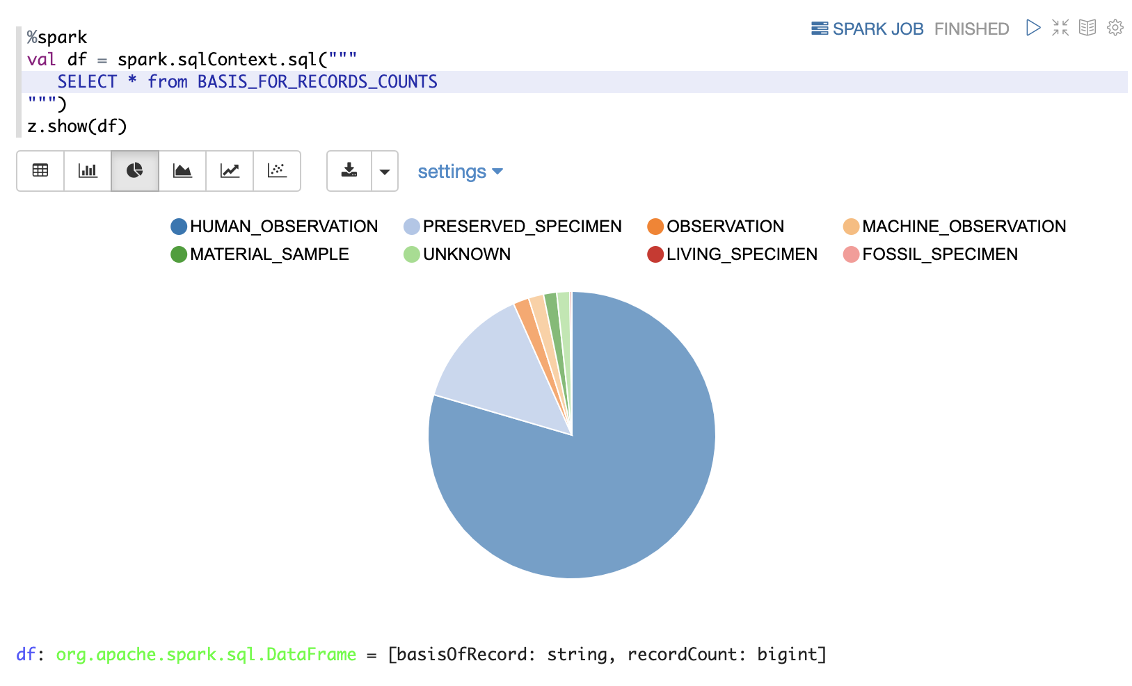
Analytics
Area for further work
Open source
Jupyter Notebooks
Apache Zeppelin
Apache Hive
Commercial
Amazon Athena
DataBricks

Slide 28
Further work

Slide 29
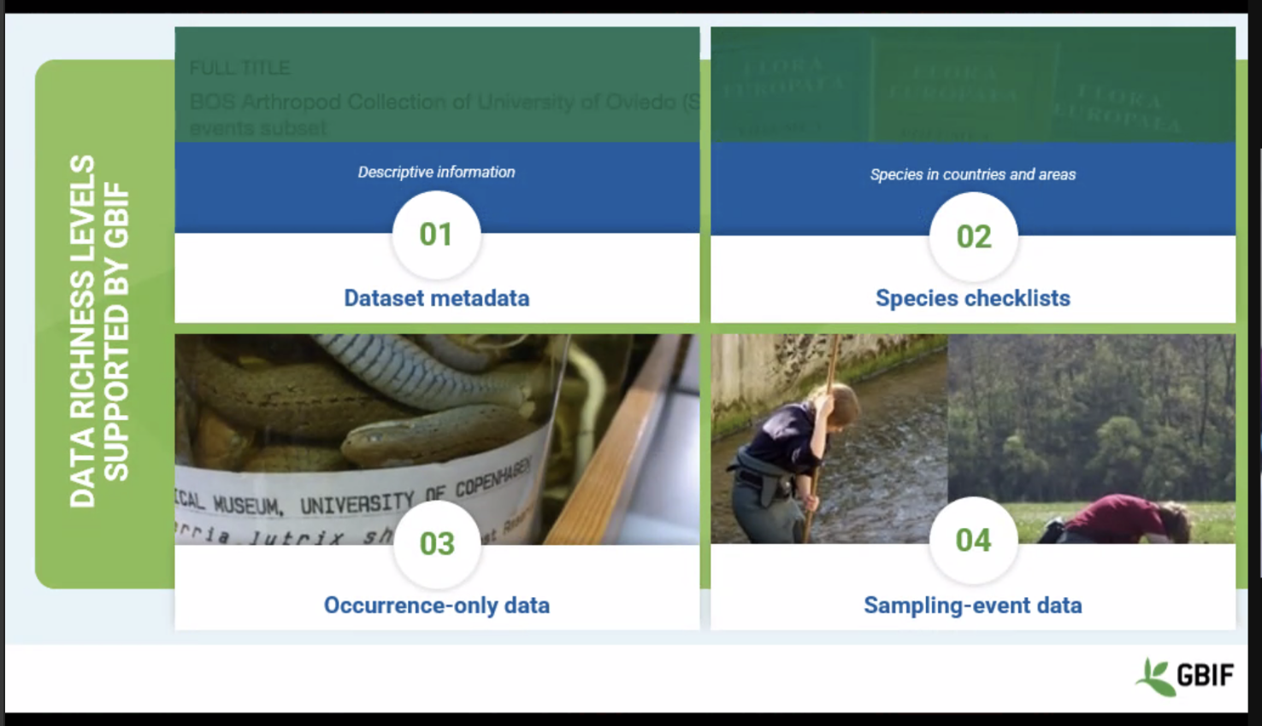
Extended data
GBIF work program to handle sampling/survey data
Possible to collaborate

Slide 30
Thank you
Fellow Pipeliners:
Javier, Peggy, Alex, Matt, Mahmoud, Doug, Bai, Robina, Simon, Adam, Bruce, Nick, Vicente, Verity, Hamish

